Slide 1

The History and Legacy of Ancient Civilizations
A Brief Overview of Key Ancient Civilizations

Slide 2
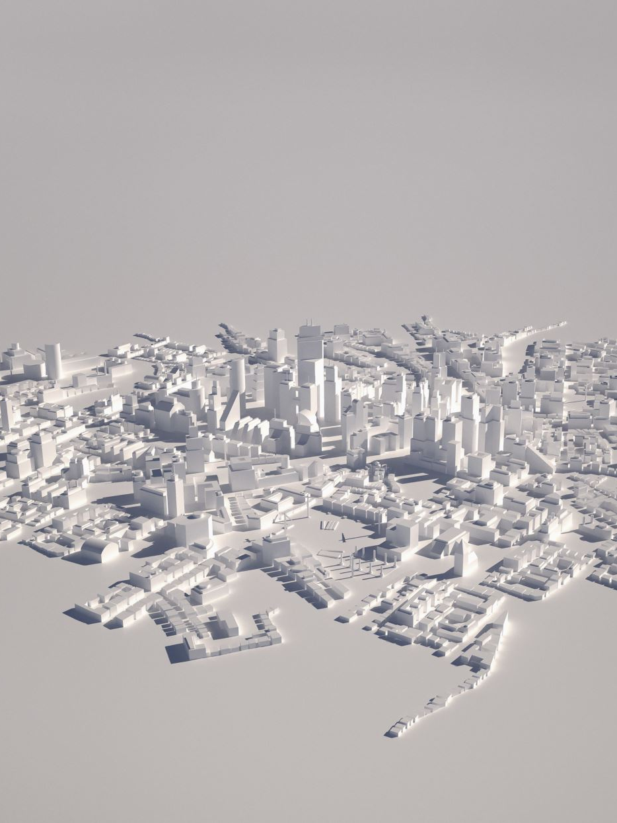
Introduction
Ancient civilizations shaped modern society in multiple ways.
They laid the foundations for governance, writing, and technological advances.
This presentation covers the Sumerians, Egyptians, Greeks, Indus Valley, and Ancient China.
Explore the history and legacy of these influential civilizations.

Slide 3
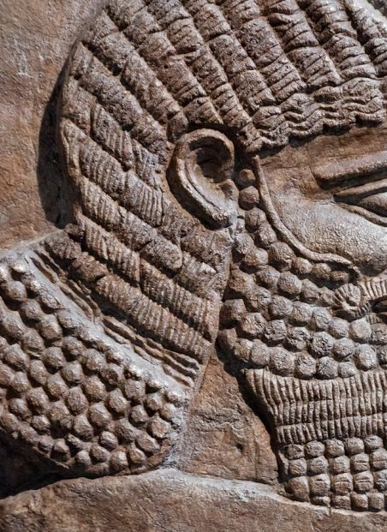
Sumerians - History
The Sumerians were one of the earliest known civilizations in Mesopotamia (c. 3100 BCE to c. 539 BCE).
They formed independent city-states like Ur, Uruk, and Lagash, each governed by its own ruler and dedicated to a patron deity
Mesopotamian civilization included the Sumerian city-states, Akkadian Empire, Assyrian Empire, Neo-Babylonian Empire.
The end of Mesopotamian civilization is marked by the fall of the Neo-Babylonian Empire in 539 BCE, followed by its assimilation under Persian, Greek, and Roman rule.

Slide 4
Sumerians - History
The Sumerians were one of the earliest known civilizations in Mesopotamia (c. 3100 BCE to c. 539 BCE).
They created one of the first writing systems, cuneiform, for record-keeping.
Established city-states like Ur, with advances in law and governance.
Sumerians invented the wheel and made significant advances in mathematics and astronomy.

Slide 5
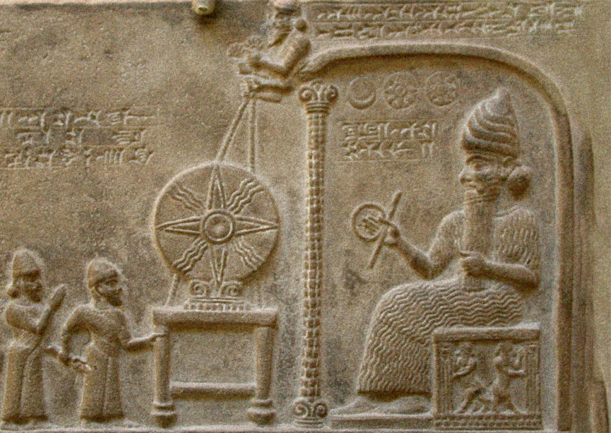
Sumerians - Legacy
Cuneiform writing influenced later writing systems.
Their legal systems and innovations in mathematics set the foundation for future societies.
Their architectural designs, like the ziggurats, influenced later civilizations.
Many of their cultural and technological advances were adopted by future empires.

Slide 6
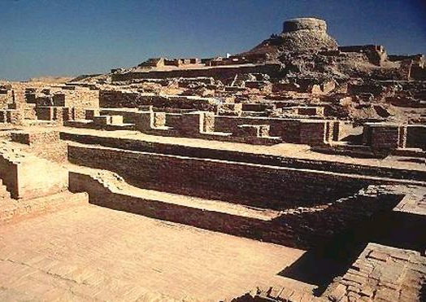
Indus Valley - History
The Indus Valley Civilization (c. 3300 - 1300 BCE) flourished in present-day Pakistan and India.
Known for advanced urban planning, including drainage systems and grid-like streets.
Major cities included Harappa and Mohenjo-Daro.
They developed a form of writing, though it remains undeciphered.

Slide 7
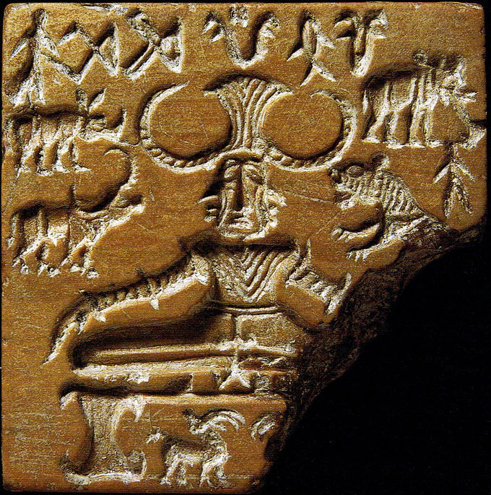
Indus Valley - Legacy
The cities of the Indus Valley were models of urban planning, influencing later civilizations.
Their advanced drainage systems and public baths influenced sanitation practices.
The undeciphered script remains a mystery and a subject of ongoing research.
Their trade networks reached as far as Mesopotamia and ancient Persia.

Slide 8
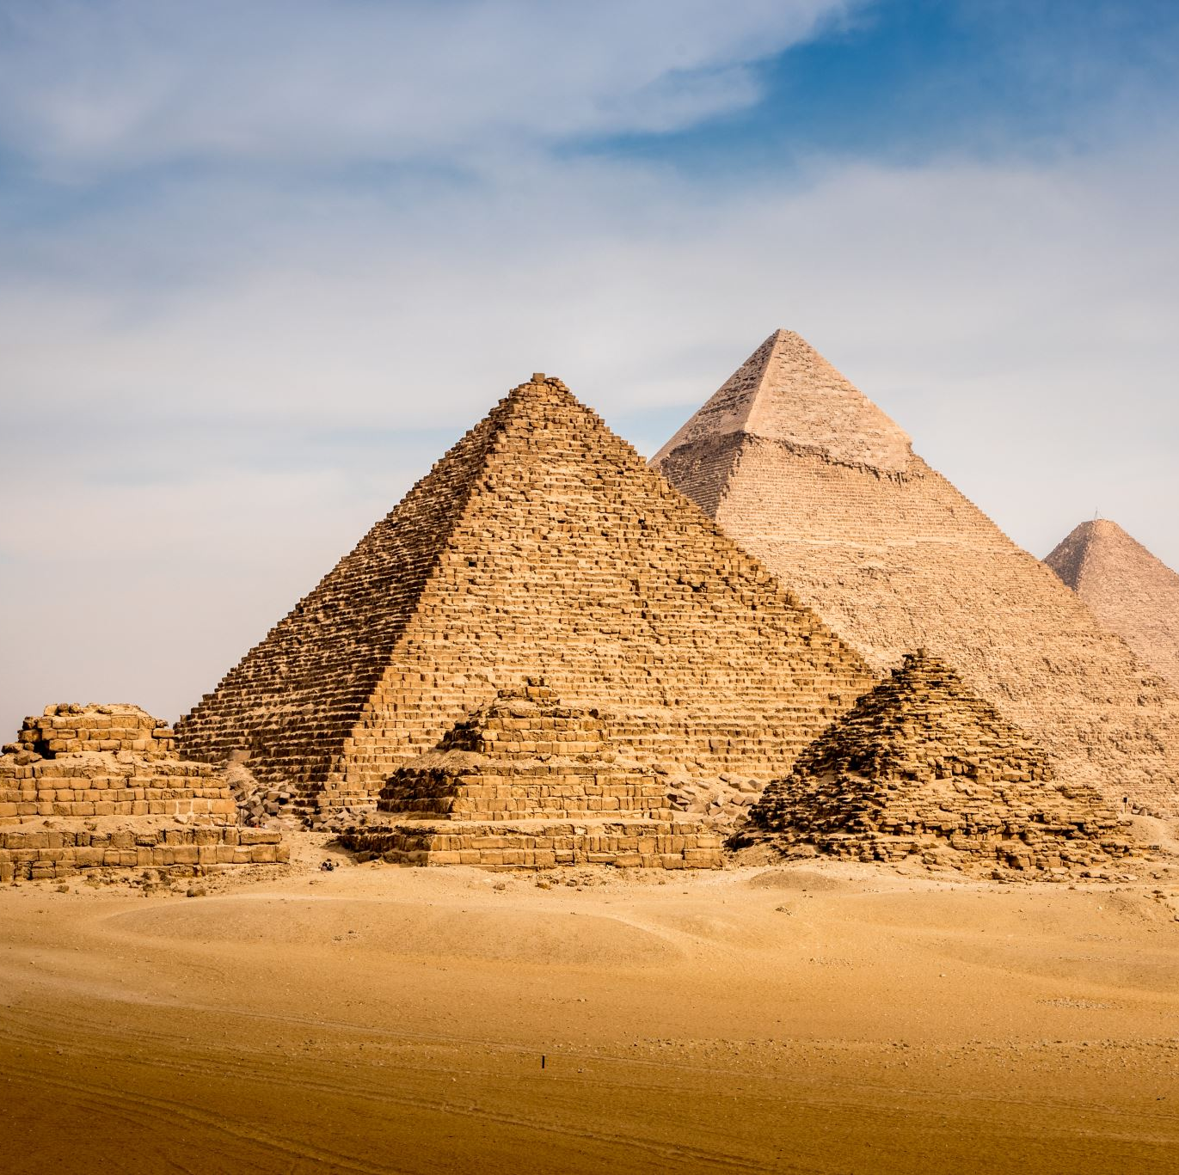
Ancient Egypt - History
Ancient Egypt flourished along the Nile River (c. 3100 BCE to c. 30 BCE).
Known for its pharaohs, pyramids, and elaborate burial practices.
Developed hieroglyphics, a complex writing system.
Pioneered advances in architecture, mathematics, and medicine.

Slide 9
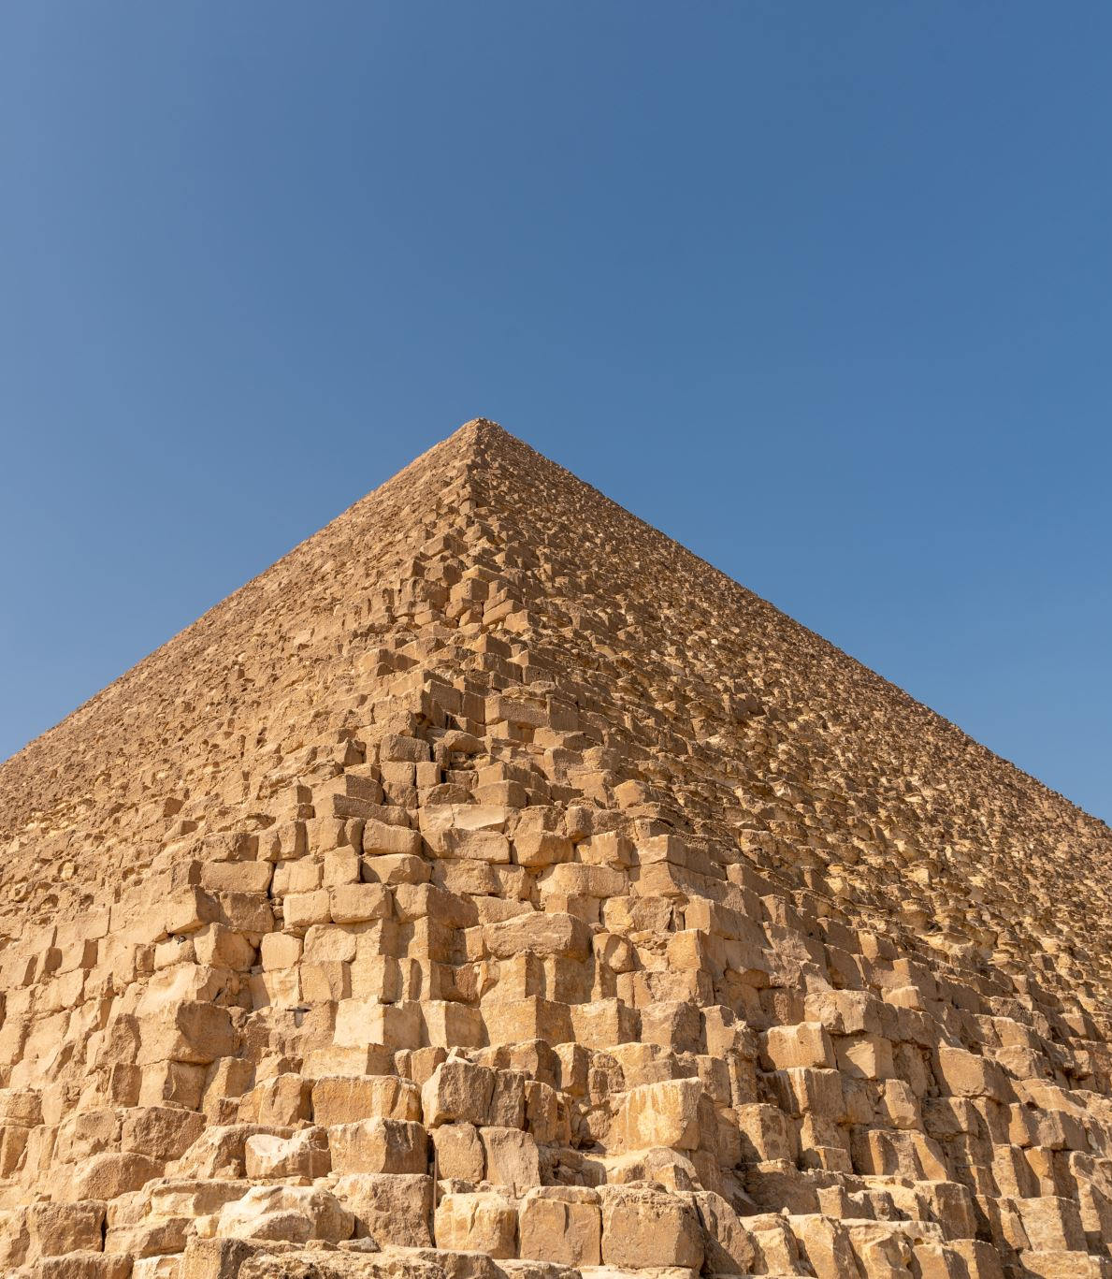
Ancient Egypt - Legacy
Monuments: Pyramids and temples are iconic landmarks of Ancient Egypt's architecture and religion.
Hieroglyphics: Influenced later writing systems, particularly in the Mediterranean, shaping communication and record-keeping.
Medicine: Advanced in areas like surgery, laying the groundwork for future medical innovations.
Governance: The structure of the centralized power under the pharaohs influenced the governance of later states.

Slide 10
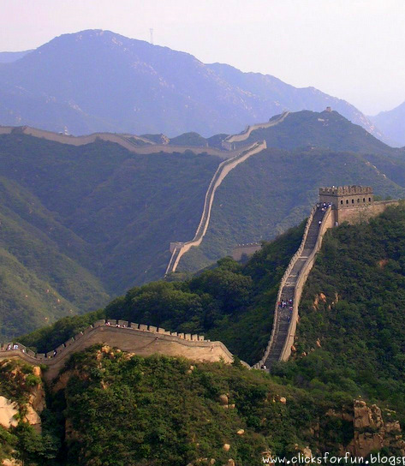
Ancient China - History
Great Wall of China: Built to protect against invasions and unify territories during the Qin Dynasty.
Inventions: Paper, gunpowder, compass, and silk were significant contributions to the world.
Dynasties: Ancient China was ruled by powerful dynasties like Shang, Zhou, Qin, and Han.
Philosophy: Confucianism and Taoism shaped Chinese culture and governance.

Slide 11
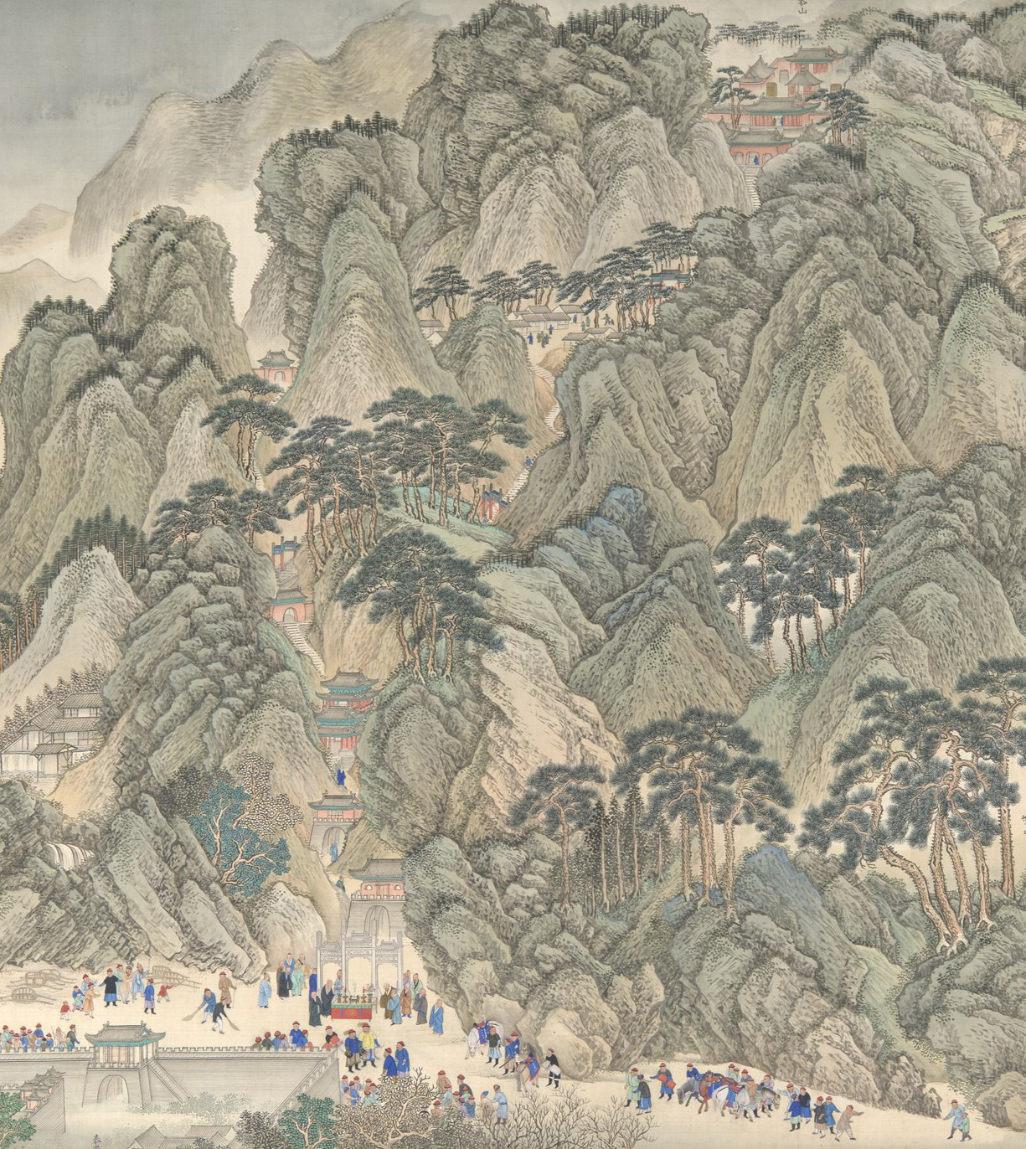
Ancient China - Legacy
Innovations: Influential inventions like paper, silk, the compass, and gunpowder revolutionized the world.
Philosophical Impact: Confucianism and Taoism continue to influence modern thought, ethics, and governance.
Cultural Heritage: Iconic landmarks like the Great Wall and Chinese calligraphy remain symbols of Chinese identity.
Silk Road Trade: Established a foundation for global trade, connecting Asia, Europe, and Africa.

Slide 12

Ancient Greece - History
Ancient Greece (c. 1200 BCE - 323 BCE) was composed of city-states, like Athens and Sparta.
Known for its development of democracy, especially in Athens.
Pioneers in philosophy, with thinkers like Socrates, Plato, and Aristotle.
Major contributions to mathematics, science, and art.

Slide 13
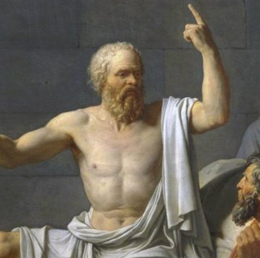
Ancient Greece - Legacy
Democracy, a system of government born in Athens, remains central in modern politics.
Philosophical and scientific thinking from Greece still shapes modern thought.
Greek art, architecture, and literature continue to influence Western culture.
The Olympic Games, originating in Greece, are still celebrated globally.

Slide 14

Conclusion
Ancient civilizations significantly shaped modern culture, governance, and philosophy.
They introduced remarkable advancements in science, engineering, and urban planning.
These societies thrived on trade, knowledge-sharing, and cultural integration.
Their achievements and challenges continue to inspire resilience and innovation today.

